Slide 1

Ontologies and Databases
Ian Horrocks
<ian.horrocks@comlab.ox.ac.uk>
Information Systems Group
Oxford University Computing Laboratory

Slide 2
What is an Ontology?
A model of (some aspect of) the world
Introduces vocabulary relevant to domain
  Often includes names for classes and relationships
Specifies intended meaning of vocabulary
  Typically formalised using a suitable logic
  E.g., OWL formalised using SHOIQ description logic
Consists of two parts
  Set of axioms describing structure of the model
  Set of facts describing some particular concrete situation

Slide 3
Axioms
Describe the structure of the model, e.g.:
Class: HogwartsStudent
EquivalentTo: Student and attendsSchool
value Hogwarts
Class: HogwartsStudent
SubClassOf: hasPet only (Owl or Cat or Toad)
ObjectProperty: hasPet
Inverses: isPetOf
Class: Phoenix
SubClassOf: isPetOf only Wizard

Slide 4
Facts
Describe some particular concrete situation, e.g.:
Individual: Hedwig
Types: Owl
Individual: HarryPotter
Types: HowgwartsStudent
Facts: hasPet Hedwig
Individual: Fawkes
Types: Phoenix
Facts: isPetOf Dumbledore

Slide 5
Obvious Database Analogy
Ontology axioms analogous to DB schema
  Schema describes structure of and constraints on data
Ontology facts analogous to DB data
  Instantiates schema
  Consistent with schema constraints
But there are also important differences…

Slide 6
Database -v- Ontology
Database:
Closed world assumption (CWA)
  Missing information treated
  as false
Unique name assumption (UNA)
  Each individual has a single, unique name
Schema behaves as constraints on structure of data
  Define legal database states
Ontology:
Open world assumption (OWA)
  Missing information treated
  as unknown
No UNA
  Individuals may have more
  than one name
Ontology axioms behave like implications (inference rules)
  Entail implicit information

Slide 7
Database -v- Ontology
E.g., given facts/data:
    Individual: HarryPotter
    Facts: hasFriend RonWeasley
    hasFriend HermioneGranger
    hasPet Hedwig
    Individual: Draco Malfoy
Query: Is Draco Malfoy a friend of HarryPotter?
  DB: No
  Ontology: Don’t Know
    OWA (didn’t say Draco was not Harry’s friend)

Slide 8
Database -v- Ontology
E.g., given facts/data:
    Individual: HarryPotter
    Facts: hasFriend RonWeasley
    hasFriend HermioneGranger
    hasPet Hedwig
    Individual: Draco Malfoy
Query: How many friends does Harry Potter have?
  DB: 2
  Ontology: at least 1
    No UNA (Ron and Hermione may be 2 names for same person)

Slide 9
Database -v- Ontology
E.g., given facts/data:
    Individual: HarryPotter
    Facts: hasFriend RonWeasley
    hasFriend HermioneGranger
    hasPet Hedwig
    Individual: Draco Malfoy
    DifferentIndividuals: RonWeasley HermioneGranger
Query: How many friends does Harry Potter have?
  DB: 2
  Ontology: at least 2
    OWA (Harry may have more friends we didn’t mention yet)
➔

Slide 10
Database -v- Ontology
E.g., given facts/data:
    Individual: HarryPotter
    Facts: hasFriend RonWeasley
    hasFriend HermioneGranger
    hasPet Hedwig
    Types: hasFriend only RonWeasley or HermioneGranger
    Individual: Draco Malfoy
    DifferentIndividuals: RonWeasley HermioneGranger
Query: How many friends does Harry Potter have?
  DB: 2
  Ontology: 2!
➔

Slide 11
Database -v- Ontology
Insert new facts/data:
    Individual: Dumbledore
    Individual: Fawkes
    Types: Phoenix
    Facts: isPetOf Dumbledore
Response from DBMS?
  Update rejected: constraint violation
    Range of hasPet is Human; Dumbledore is not Human (CWA)
Response from Ontology reasoner?
  Infer that Dumbledore is Human (range restriction)
  Also infer that Dumbledore is a Wizard (only a Wizard can have a pheonix as a pet)

Slide 12
DB Query Answering
Schema plays no role
  Data must explicitly satisfy schema constraints
Query answering amounts to model checking
  I.e., a “look-up” against the data
Can be very efficiently implemented
  Worst case complexity is low (logspace) w.r.t. size of data

Slide 13
Ontology Query Answering
Ontology axioms play a powerful and crucial role
  Answer may include implicitly derived facts
  Can answer conceptual as well as extensional queries
    E.g., Can a Muggle have a Phoenix for a pet?
Query answering amounts to theorem proving
  I.e., logical entailment
May have very high worst case complexity
  E.g., for OWL, NP-hard w.r.t. size of data
  (upper bound is an open problem)
  Implementations may still behave well in typical cases

Slide 14
When to Use an Ontology?
Consider using an Ontology when
  Schema is large and/or complex and/or used at query time
    Can use reasoning to structure and check schema
    Infered answers and/or intensional queries
  Not possible/reasonable to assume complete information
    E.g., modeling complex structures or activities
  Willing to pay potential performance cost
Consider using a DB when
  Schema is small and/or simple and/or not used at query time
  Complete information is available
    E.g., booking systems
  Need performance guarantees

Slide 15
Ontology Based Information Systems
Analogous to relational database management systems
  Ontology ¼ schema; instances ¼ data
Some important (dis)advantages
  (Relatively) easy to maintain and update schema
    Schema plus data are integrated in a logical theory
  Query answers reflect both schema and data
  Can deal with incomplete information
  Able to answer both intensional and extensional queries
  Semantics may be counter-intuitive or even inappropriate
    Open -v- closed world; axioms -v- constraints
  Query answering (logical entailment) much more difficult
    Can lead to scalability problems

Slide 16

Ontology Based Information Systems
Similar to relational databases
  Ontology ¼ schema; instances ¼ data
Some important (dis)advantages
  (Relatively) easy to maintain and update schema
    Both schema and data are “self organising”
  Query answers reflect both schema and data
  Able to answer both intensional and extensional queries
  Semantics may be counter-intuitive or even inappropriate
    Open -v- closed world; axioms -v- constraints
  Query answering (logical entailment) much more difficult
    Can lead to scalability problems
Very powerful, but not miraculous!

Slide 17
Best of Both Worlds?
W3C OWL working group is developing OWL 2
  OWL 2 is an update to OWL adding many useful features
    Increased expressive power, e.g., w.r.t. properties
    Extended support for datatypes and values
    Database style keys
    Rich annotations
OWL 2 also defines several profiles
  Profile is a language subset with
    Useful computational properties
    Useful implementation possibilities

Slide 18
Best of Both Worlds?
EL++ profile
  Maximal language for which reasoning (including query answering) known to be worst-case polynomial
  Captures expressive power used by many large-scale ontologies
    Features include existential restrictions, intersection, subClass, equivalentClass, class disjointness, range and domain, transitive properties, …
    Missing features include value restrictions, Cardinality restrictions (min, max and exact), disjunction and negation

Slide 19
Best of Both Worlds?
DL-Lite profile (not to be confused with OWL Lite!)
  Maximal language for which reasoning (including query answering) is known to be worst case logspace (same as DB)
  Captures (most of) expressive power of ER/UML schemas
    Features include limited form of existential restrictions, subClass, equivalentClass, disjointness, range and domain, symmetric properties, …
  Query answering can be implemented using query rewriting
    Resulting SQL query/queries capture all information from axioms
    Can use query/queries with standard DBMS and relational data

Slide 20
Best of Both Worlds?
OWL-R profile
  Allows for scalable (polynomial) reasoning using rule-based technologies
  Includes support for most OWL features
    But standard semantics only apply when they are used in a restricted way
    Related to DLP and pD*
  Can be implemented on top of rule extended DBMS
    E.g., Oracle’s OWL Prime implemented using forward chaining rules in Oracle 11g

Slide 21
Summary
Ontologies consist of sets of axioms and facts
Analogous to DB: axioms ¼ schema; facts ¼ data
Important differences in semantics
  DB: UNA, CWA and constraints
  Ontology: OWA and implications
Ontologies are very powerful, but there are costs
  Can be scalability problems
OWL 2 provides choice of several profiles
  Tractable reasoning (logspace or polynomial)
  Different features and implementation pathways

Slide 22
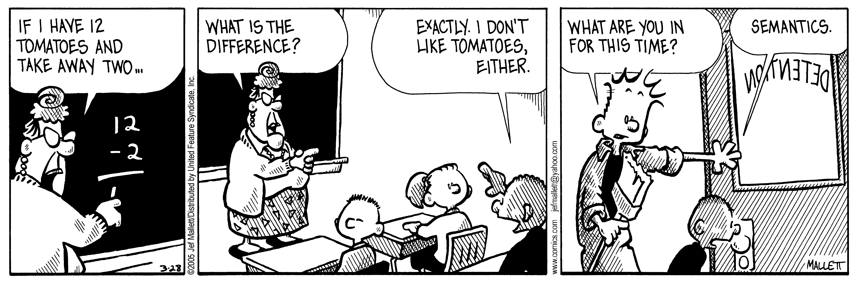
Thank you for listening
Any questions?

